Slide 1
Policy & Advocacy to Advance Mental Health and Wellbeing
Policy and Advocacy: Transforming Mental Wellbeing for Boys and Men
Notes:
1

Slide 2
Advocacy is public support for or recommendation of a particular cause or policy
Definition as shared and used by Alliance for Justice, Bolder Advocacy

Slide 3



Why Advocate?
Advocacy shapes the public debate and understanding about mental health & wellbeing (refer to Changing the Narrative module for messaging guidance).
Advocacy influences public policies and organizational practices that impact mental health & wellbeing.
Advocacy shines a spotlight on community power, voice, and leadership in shaping strategies and approaches that impact mental health & wellbeing.

Slide 4
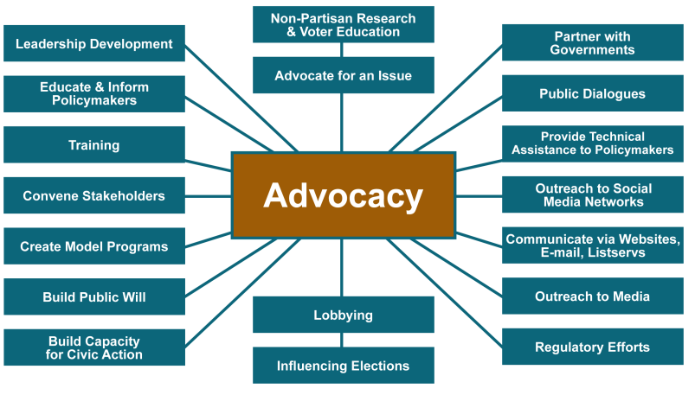
Advocacy can take different forms
Figure courtesy of PolicyLink,

Slide 5
What is Lobbying?
Lobbying is one form of advocacy: While all lobbying activities are advocacy, most advocacy activities are not lobbying (refer to previous slide for examples).
There are 2 types of lobbying:
    DIRECT lobbying is a communication to a legislator (or their staff) that expresses a view about specific legislation.
    GRASSROOTS lobbying is a communication to the general public that expresses a view about specific legislation and includes a call to action.

Slide 6
Understanding Lobbying
Non-profits can engage in limited amounts of lobbying. However, it is important to understand which of your funding sources expressly prohibit the use of their funds for lobbying. Any lobbying should be done with unrestricted funds.
It is very important to get expert lobbying advice to understand your own organizational situation.
Alliance for Justice’s Bolder Advocacy website offers great resources and their attorney coaches provide free technical assistance: www.bolderadvocacy.org or 1-866-NP-LOBBY

Slide 7
Taking a Closer Look at Policy
One goal of advocacy activities is to influence and strengthen policy.
Policies are the rules and principles that guide the activities of government, businesses and institutions, and that determine the allocation of resources.
There are different types of policy:
  Organizational—e.g. Policy manuals and standards
  Regulatory—e.g. Administrative rules; regulations; Executive Orders;
  Fiscal—e.g. Annual budgets acts; appropriations
  Legislative—e.g. Bills; laws/referenda; ballot propositions
  Legal—e.g. Court decisions

Slide 8
Examples of Making Connections Policy Wins
Advocating for local transit policy change
Improving organizational practices to support young men
Changing local health department policies and practices
Engaging in community participatory budgeting

Slide 9
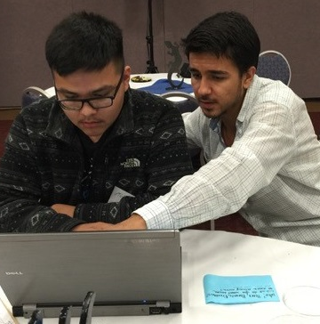
Policy example: Albuquerque, NM
At the beginning of the COVID-19 pandemic, schools in Albuquerque closed for the school year and transitioned to offering hot meals at breakfast and lunch.
Making Connections: International District worked with partners to advocate that the city provide free bus passes for students without reliable transportation so that they could get to school and access the meals.
Notes:
The MC: ID Alliance is a coalition of partners committed to realizing a vision in which young men of color are leaders who experience social and emotional wellbeing in a safe and healthy community, with access to systems that work with and for them through transformational spaces, experiences and relationships, in multiple places in the ID
Expected outcomes include improved social and emotional wellbeing for YMOC, more equitable youth-serving systems, and a healthier and safer International District.
At the beginning of the pandemic, schools in Albuquerque closed for the school year and transitioned to offering hot meals at breakfast and lunch. But many of the families with the highest need had no way of getting to the schools without school busses running. So MC:ID and its partners successfully advocated for the city to provide free bus passes to students so they can get to schools to pick up free meals.

Slide 10
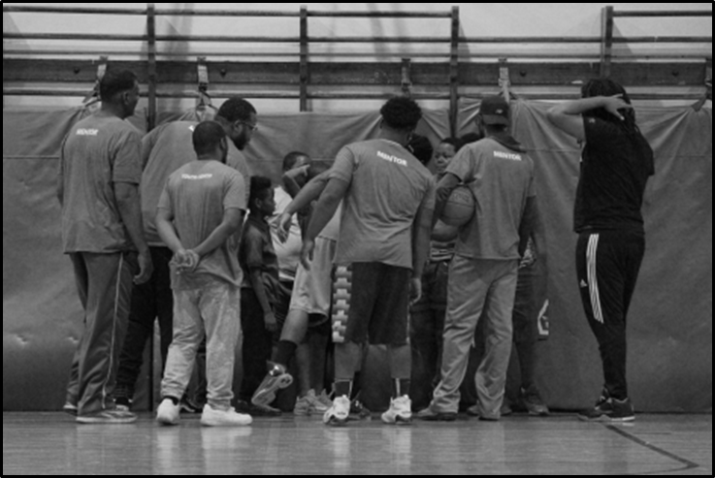
Policy example: Chicago, IL
Sinai Health System’s Under the Rainbow program is a trauma-informed sports and play initiative that provides youth a safe space to play and be kids, connect with and develop consistent and healthy relationships with adults, talk about their feelings, and develop leadership skills through a youth board of directors that leads all decision making for the programming.
The organization has changed its organizational policy to support hiring young men from the community in mentor roles and make hospital vans available to transport them to meetings and events.
Notes:
In Chicago, Legends of Lawndale, a project out of Sinai Health System, recognized the need to address youth and community needs and provide opportunities.
This has taken the role of a trauma-informed sports and play initiative that provides youth a safe space to play and be kids, connect with and develop consistent and healthy relationships with adults, talk about their feelings, and develop leadership skills through a youth board of directors that leads all decision making for the programming. This is especially important in neighborhoods with high rates of violence and which lacks opportunities for boys and young men of color.
The initiative is also incorporating restorative practices and ongoing discussions on the meaning of manhood and boyhood, and giving the young leaders the opportunity to rewrite and redefine community narrative through photojournalism component.
In West Chicago, where rates of violence are high and economic investment and employment opportunities are limited, poverty, trauma, and stress are widespread, especially among the community’s youngest residents.
How would relationships and communities change if we replaced fear with trust? In West Chicago, the Chicago Making Connections coalition asked this question and chose safe places to play as the change lab. With a vision of men and boys of color feeling a sense of belonging, ownership, and safety in a thriving community, Chicago Making Connections has created safe environments for play, mentorship, and community action.
Coalition Partners are collaborating to:
Lead afterschool coaching and mentoring programs in the North Lawndale and South Lawndale neighborhoods of West Chicago. These programs offer sports like basketball as well as support and mentoring to help young men be better able to communicate their needs, understand their emotions, and problem solve.
Empower young men to lead the development and implementation of these programs, called Legends of Lawndale and La Villita Warriors, through a Youth Board of Directors.
Create meaningful employment opportunities for men 16-65 as coaches and mentors of younger men.
Position Sinai Hospital, the area’s only level-one trauma center, as an agent of community change who is involved before violence occurs, instead of only afterward through their emergency department.
Legends of Lawndale has improved the mental health and wellbeing of boys and young men of color in Chicago neighborhoods where violence and trauma are the norm. By creating safe spaces for play, peer-support programs and meaningful employment opportunities, the program has improved social connectedness and healthy relationships among men. It has also promoted civic engagement and advocacy.

Slide 11
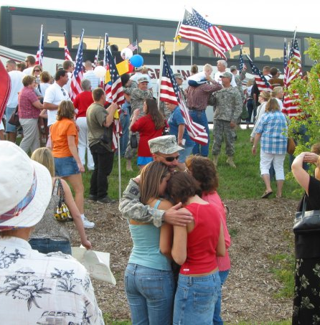
Policy example: Nebraska
The Nebraska Association of Local Health Directors trained staff at 73 local county health departments and other agencies to support veterans in rural Nebraska so that they have the resources they need to successfully reintegrate.
They have also assisted public agencies to improve their veterans’ policies, positioning Nebraska communities to be there when their veterans need them.
Photo: Teri Clark, Nebraska Association of Local Health Directors
Notes:
The U.S. Department of Veteran Affairs (VA) estimates that 143,375 Veterans live in Nebraska – 92% are men and more than 60% live in rural communities.
these veterans often experience broken relationships, housing and financial insecurity and are at higher risk for several negative health outcomes—most alarmingly, suicide.
NALHD is extending its scope to help ensure that families are connected and part of networks of trust that will help them support their Veteran’s wellbeing and effectively cope with and mitigate crises when they arise.
Those supported families will be better-prepared to help their Veterans (their fathers, grandfathers, and sons) be well and stay connected to systems of support.
VetSET Nebraska works to ensure that veterans returning to rural Nebraska have the support and resources they need to successfully reintegrate into their families and communities. To prepare the entire community to be able to support veterans’ mental health and wellbeing, VetSET trains and supports organizations and agencies that interact with veterans and their families to recognize veterans’ unique needs and respond to them in a way that’s sensitive to their culture. This couldn’t be more important than in the case of recognizing veterans who are at risk of suicide.
Coalition partners are collaborating to implement the following activities:
Work with veterans, military service members, and their families through the health departments in 73 Nebraska counties to ensure whole communities will know how to and be ready to support veterans throughout rural Nebraska.
Train and support social services organizations, law enforcement, faith-based organizations, educational institutions, health clinics, government agencies, employers, and others that interact with veterans and their families. The training for these organizations includes not only explaining veterans’ challenges, which can cause them to feel isolated or unprepared for civilian life, but also highlighting their strengths.
Work with the spouses, children, and other family members of veterans and military service members to create a trauma-informed home and community environment.
VetSet has ensured that local health departments in rural Nebraska understand the health and mental health needs of veterans and can respond to them in a culturally competent way. They have also trained numerous organizations and agencies that interact with veterans throughout the state, as well as assisted them with improving their veterans’ policies, which has positioned Nebraska communities to be there when their veterans need them.

Slide 12
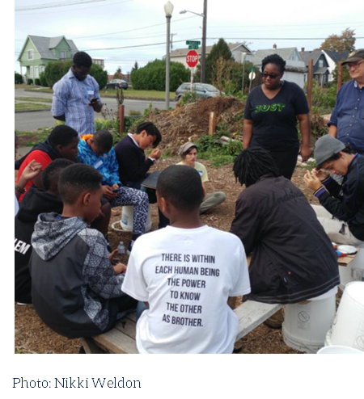
Policy example: Tacoma, WA
Tacoma-Pierce County Health Department engages community members in community participatory budgeting to make decisions about how to allocate public resources.
Through participatory budgeting, seven local grassroots organizations serving communities of color vote every year on how to allocate $100,000 to advance community wellbeing.
Using its institutional power to pool resources and its legitimacy in the public eye, TPCHD funds community projects that address mental wellbeing in upstream and culturally-relevant ways.
Notes:
The Tacoma-Pierce County Health Department (TPCHD) in Pierce County, Washington, is overseeing the implementation of a Participatory Budgeting (PB) approach. PB gives community members the power to determine how public funds should be allocated to address identified community issues. The PB approach lends itself to the equitable distribution of public funds, as it empowers community members to control the budgeting process and to ensure that public funds are reflective of community needs and values. TPCHD is overseeing an innovative application of PB by seeking participatory engagement through the educational system, implementing PB in three schools—one elementary school, one middle school, and one high school—in East Tacoma, Washington. TPCHD is guiding community members, including students and teachers, to develop ideas and proposals for community improvement projects, enabling them to vote to determine which proposals will be implemented, and then allocating funding to implement the winning proposals. This project was implemented with funding and support from the Robert Wood Johnson Foundation (RWJF) through the Public Health National Center for Innovations (PHNCI) Public Health Innovations Implementation Grant Program. Early Success include:
Visibility and credibility within the community. Due to their experiences implementing the PB project, according to TPCHD staff, the community views their agency as more of a leader and guiding force within the community. They described that others in the community view TPCHD as a credible expert that can support the implementation of PB in other agencies
Implementation of PB across sectors. To support PB implementation, TPCHD conducted a community visioning process that included regional funders, consultants, elected officials, and community stakeholders to discuss how to advance PB as a community engagement strategy. This stakeholder group recommended adding PB into the services offered by the Public Health Centers of Excellence, which is a partnership formed between TPCHD and Spokane Regional Health District. The Centers is committed to disseminating innovative practices, recovering costs, and improving population health. Since being promoted through the Centers, PB is being implemented across sectors – in healthcare agencies, funders, and cities throughout Pierce County and beyond.
To create opportunities for grassroots organizations to address their communities’ needs most effectively, MCI recognized the role that funding decisions play. TPCHD is unflinching in its acknowledgement of the idea that the community knows best—that’s why participatory budgeting as a strategy made perfect sense. Participatory budgeting is the process of community members coming together to make decisions about how to allocate resources. Through this process, grassroots organizations have been funded to continue and expand their impactful work. Before MCI convened, Hilltop Urban Gardens (HUG) addressed the ancestral trauma of slavery by reconnecting black residents with the healing practices of cultivating food. Not only were they able to address access to healthy food by growing 1,000 pounds of fresh produce, they also created space for neighbors to strengthen their cultural bonds. Through participatory budgeting, HUG—along with six other grassroots organizations serving communities of color—vote every year on how to allocate $100,000 to advance community wellbeing. With its institutional power to pool resources and its legitimacy in the public eye, TPCHD funds community projects that address mental wellbeing in upstream and culturally-relevant ways. Since receiving MCI funding, HUG’s food production is up to 4,000 pounds, food that is redistributed to community members in exchange for their commitment to share their talent, treasure or time with other community members or with HUG. MCI shares that “this grant has built capacity among people of color-led grassroots organizations resulting in greater ability of MCI partners to collaborate, obtain new grants, and implement activities that promote mental wellbeing.”
These include:
Tacoma Urban League (TUL), which receives funding through participatory budgeting in recognition of the impact their programming has on the wellbeing for youth of color. Currently, 54 young men receive mentoring through TUL’s Male Improvement Program.
Centro Latino (CL), which receives funding through participatory budgeting to provide space for grassroots community organizations to gather, plan, and organize.
Consultants for Indian Progress (CIP), which receives funding through participatory budgeting to support their All My Relations program for indigenous youth and to advance their innovative Paddles Up, Families Strong curriculum that ties urban natives to deep cultural practices such as the Tribal Canoe Journey.
La Resistencia (Latino Advocacy, LLC), which receives funding through participatory budgeting to visit, communicate and advocate for immigrants who are detained at the Northwest Detention Center so that they can remember that they, “Are not Alone”.
Canoe Journey Herbalists (CJH), which receives funding through participatory budgeting to continue their First Foods and Medicines project that provides the community with natural herbs and healing balms and tonics.
•API Chaya, which does not receive funding but is a member of the coalition to prevent domestic violence and is helping to address trauma within our communities through skill-building and relationship-building.
The 253 Making Connections Coalition has been able to successfully leverage the momentum ofthe national Making Connections initiative to support community-driven strategies for the mental health and wellbeing of the community in Tacoma.

Slide 13
Four Elements of a Successful Policy Strategy
1.
Assess the Policy Landscape and Define a Policy Objective
2.
Develop Policy Language for Effective Implementation
3.
Build and Maintain a Strong, Broad Base of Support
4.
Back up the Case

Slide 14
Four Elements of a Successful Policy Initiative
1.
Assess the Policy Landscape and Define a Policy Objective
2.
Develop Policy Language for Effective Implementation
3.
Build and Maintain a Strong, Broad Base of Support
4.
Back up the Case
Notes:
First, we’ll be touching on assessing the policy landscape to pinpoint and define policy objectives for your initiative or campaign.
“Policy landscape” is used here to describe any factor in the social, political, economic, public, and private spheres that influences policy-making or contributes to inaction. The policy landscape pertains to the level of civic involvement, the political orientation of elected officials, and the role of vested interests in shaping public opinion and political decision-making. Understanding the broad contours of an issue, knowing where the community stands, and being clear about the legislative process as well as jurisdiction-specific conventions that key decision-makers follow are critical ingredients for designing and implementing local prevention policy.

Slide 15
Assess the Policy Landscape
Identify a specific policy objective.
Determine if a new policy is needed.
Determine level/jurisdiction for change.
Identify key decision makers.
Assess parameters of advocacy activities.

Slide 16
Assess the Policy Landscape
Identify a specific policy objective
Consider community strengths, assets, interests and needs of those most impacted.
Identify opportunities to advance health equity and racial justice.
Craft policy objectives as part of a broader agenda.
Consider feasibility and ‘win-ability’.
Assess the policy context- consider trending local, state, regional and national issues that are shaping the debate.

Slide 17
Assess the Policy Landscape
Assess if a new policy is needed:
  Investigate current and past policy initiatives.
  Connect with government officials, policy makers and key players to assess what’s worked.
  Review existing data.
  Conduct a community assessment to inventory strengths, assets and potential challenges.

Slide 18
Assess the Policy Landscape
Determine the appropriate venue for action and identify key decision makers
Consider level of policy change needed: organizational/institutional, local, county, state, federal
Identify the appropriate jurisdiction for local policy changes:
City councils
County commissions, or boards of supervisors
Local boards of health
Transportation authorities
Planning commissions
Park districts
Metropolitan planning organizations
School districts

Slide 19
Four Elements of a Successful Policy Initiative
1.
Assess the Policy Landscape and Define a Policy Objective
2.
Develop Policy Language for Effective Implementation
3.
Build and Maintain a Strong, Broad Base of Support
4.
Back up the Case
Notes:
One of the most important elements of a local policy campaign is the development of policy language. Providing draft language for policymakers to promote as the legislative vehicle for your policy offers distinct advantages, in particular the ability to initiate the policy development process with provisions that are determined to be strong and effective.

Slide 20
Plan for Effective Implementation & Evaluation
Develop strong policy language and enforcement mechanisms.
Consider the impact on different communities.
Ensure that policy is implemented equitably.
Plan to evaluate policy impact and disseminate results.

Slide 21
Plan for Implementation & Evaluation
Develop strong policy language and enforcement provisions:
Don’t reinvent the wheel!
Refine model language to be consistent with policy objectives.
Enlist support of policy experts to review.
Build mechanisms to maximize compliance.
Determine agencies to oversee implementation and enforcement.

Slide 22
Plan for Implementation & Evaluation
Health Equity & Racial Justice Matter:
More than just placeholders—Simply inserting a person of color or a person from a low-income community is not enough.
Diverse and divergent perspectives—Engage in how perspectives differ and how those differences may influence decisions and solutions.
Honors community leadership & lived experience—Including community members in policy activities strengthens the process and outcomes.

Slide 23
Plan for Implementation & Evaluation
Planning for equitable policy evaluation and dissemination:
Identify desired process and outcomes indicators before engaging in advocacy.
Engage with your partners and population of focus to identify your evaluation metrics.
Draw on the knowledge of your evaluation partners.
Communicate and disseminate your outcomes and policy wins to maintain community support.

Slide 24
Four Elements of a Successful Policy Initiative
1.
Assess the Policy Landscape and Define a Policy Objective
2.
Develop Policy Language for Effective Implementation
3.
Build and Maintain a Strong, Broad Base of Support
4.
Back up the Case
Notes:
Meaningful engagement and involvement throughout the process – from defining issues to creating solutions and strategies – should come from diverse sectors as well as organizations and individuals from different communities, racial and ethnic groups, and income levels representative of the jurisdiction.
Emphasis should be placed on partnerships, including with elected officials and other individuals with influence.

Slide 25
Develop A Strong Base of Support
Develop & recruit local partners and supporters.
Cultivate authentic community engagement.
Identify & recruit influential champions.
Understand counter positions.

Slide 26

Policy campaigns are most effective with broad community participation and a mobilized grassroots base.
Notes:
An effort to craft or change policy will be most effective if it’s driven by broad community participation and collaboration.
When politicians are faced with a mobilized grassroots base, they are put on notice about the need to either respond to the community or publicly go on record with no stance or in opposition to these activated constituents.
Campaigns centered on well-informed and engaged community residents can typically withstand changes in the policy landscape such as newly elected politicians, long periods of inaction, or setbacks to the proposed policy because these campaigns have invested time in building a strong base that understands the political landscape and is committed to making change.

Slide 27
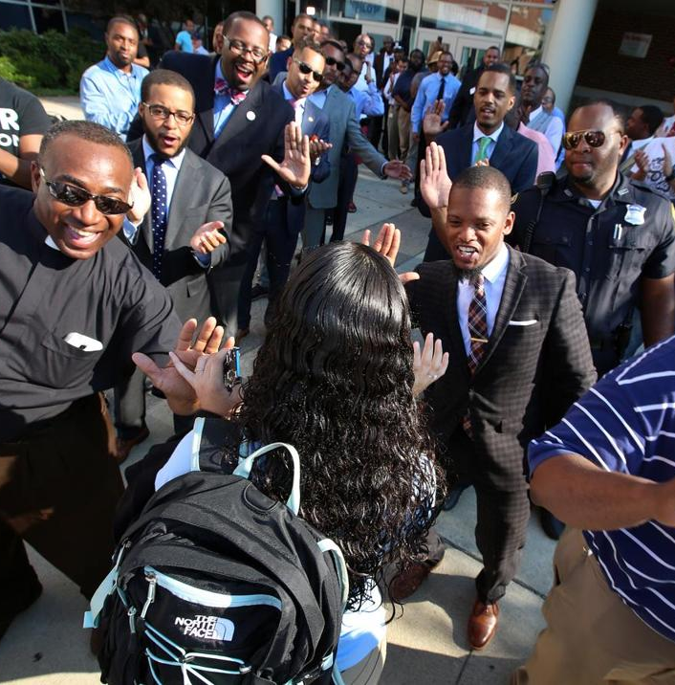
Build a Strong Base of Support
Benefits of forming a coalition:
Brings together diverse experience and skills.
Gathers wide array of perspectives.
Combines advocacy power.
Provides access to more constituencies and networks.
Creates greater focus on common goals.
Fosters sustainability.

Slide 28
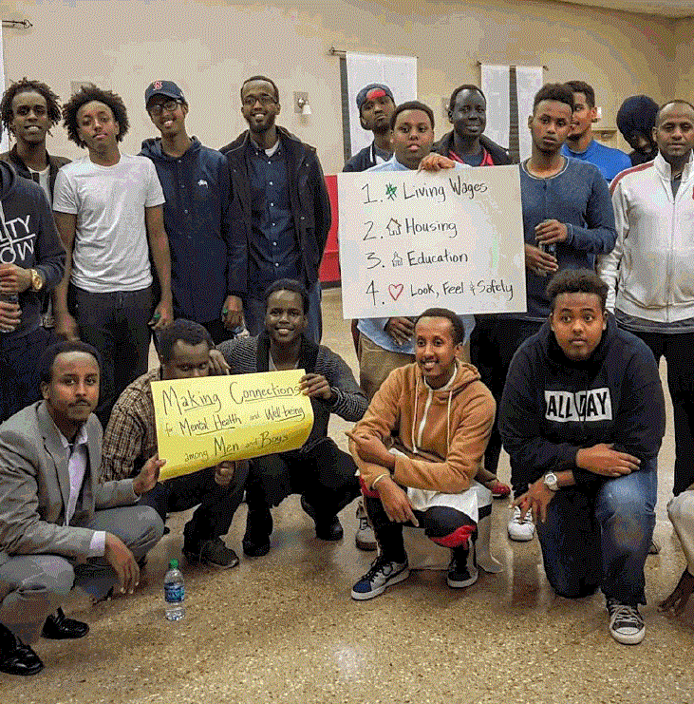
Build a Strong Base of Support
Recruit the right people for your coalition:
Identify people working on the issue.
Consider who has influence and who will be supportive.
Identify who may put obstacles in your path.
Consider who should be involved: Membership type and size; individuals and organizations

Slide 29
Build a Strong Base of Support
Build rapport with influencers & decisionmakers:
Recruit and cultivate spokespeople.
Educate decision making body and staff. NOTE: If you are educating policymakers about an issue, that is not considered “lobbying.” Please see the next two slides for more information.
Build capacity of community allies and champions.

Slide 30
Build a Strong Base of Support
Strategies for understanding your opposition:
Identify self interests and motivations.
Gauge relationships with key influencers.
Analyze materials and documentation to prepare counter arguments.
Be prepared to counter the prevailing narrative on mental health to one that focuses on community level prevention and wellbeing.
Represent your community and their strengths and needs proudly!

Slide 31
Four Elements of a Successful Policy Initiative
1.
Assess the Policy Landscape and Define a Policy Objective
2.
Develop Policy Language for Effective Implementation
3.
Build and Maintain a Strong, Broad Base of Support
4.
Back up the Case
Notes:
Successful local policy change requires much more than just the hard facts. It’s important to prepare a well-framed case, substantiate it with solid data and persuasive information, and communicate it thoughtfully.

Slide 32
Use the Media to Educate the Public & Decision Makers
…click here to learn how!

Slide 33
“MC:ID’s collaborative projects are now addressing advocacy and policy by young men of color and adult allies… to advocate for upstream strategies that change structures and systems impacting young men of color and their families.”
-- MC:ID Lead Partner

